Slide 1
Machine Learning For Micro-Credit Loans
Rohan V Borade

Slide 2
Data Set
Micro-credit loan defaulter data set.
Source : Client provided dataset.
Abstract :
Number of Instances (209593)
Attributes (Float, Integer, String)
Number Of Attributes (36) –
label,msisdn,aon,daily_decr30,daily_decr90,rental30,rental90,last_rech_date_ma,last_rech_date_da,last_rech_amt_ma,cnt_ma_rech30,fr_ma_rech30,sumamnt_ma_rech30,medianamnt_ma_rech30,medianmarechprebal30,cnt_ma_rech90,fr_ma_rech90,sumamnt_ma_rech90,medianamnt_ma_rech90,medianmarechprebal90,cnt_da_rech30,fr_da_rech30,cnt_da_rech90,fr_da_rech90,cnt_loans30,amnt_loans30,maxamnt_loans30,medianamnt_loans30,cnt_loans90,amnt_loans90,maxamnt_loans90,medianamnt_loans90,payback30,payback90,pcircle,pdate.

Slide 3
Problem Statement
This research aimed at the case of customers @ loan paid & loan not paid & compares predictive ability of loan payment among the different classification methods , the result of predictive accuracy of loan repayment will be more valuable than binary results of the classification – defaulter or not defaulter.
What to achieve : (1-Non Defaulter , 0-Defaulter)
Customers loan repayment financial capability.

Slide 4
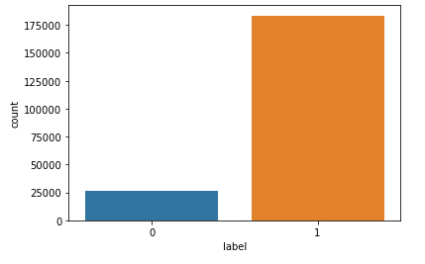

Data Exploration & Facts
Data set target column classified as below
It shows defaulter as 26162 people & non-defaulter as 183431 out of total borrower 209,593.

Slide 5
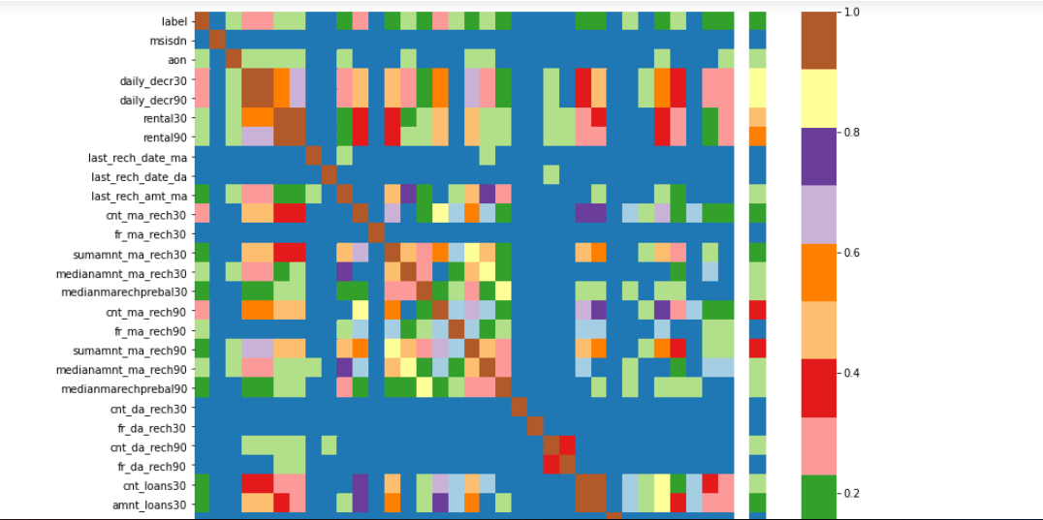
Attribute’s Correlation & Recommendations
Below plot shows mutual relation between attributes , correlation increases from light to dark color.
Recommendations-
Customer’s Loan repayment capability depends upon below –
Customer spending Daily amount in last 30 days , spending average main account balance in last 30 days, Frequency of recharge for data account & main account in 30/90 days, loan taken in last 90 days & payback time for last 30 days.

Slide 6
Requirement of Machine Learning
Will try to find out accurate prediction for defaulter & non-defaulter both.
To achieve this result , will build classification model.

Slide 7
Supervised Learning methods :
Logistic Regression – Hyper parameters
KNN – Best neighbor get picked
Decision Tree Classifier – Node Splitting on all available variables.

Slide 8
Model Training Using Numbers Of Folds = 4
Logistic Regtession : Accuracy score achieved 87.95%
KNN : Accuracy score achieved 81.67%
Decision Tree Classifier : Accuracy score achieved 77.35%
Random Forest Classifier : Accuracy scor achieved 90.51%

Slide 9
No Normalization needed.
3 feature were excluded like mobile numbers of customer & median amount for recharge in last 30/90 days as its value with outliers after applying outliers reducing technique.
Cross Validation used to picked best features.
Best Accuracy achieved as 90.51%
So far the best estimator

Slide 10
Thank you

